Slide 1
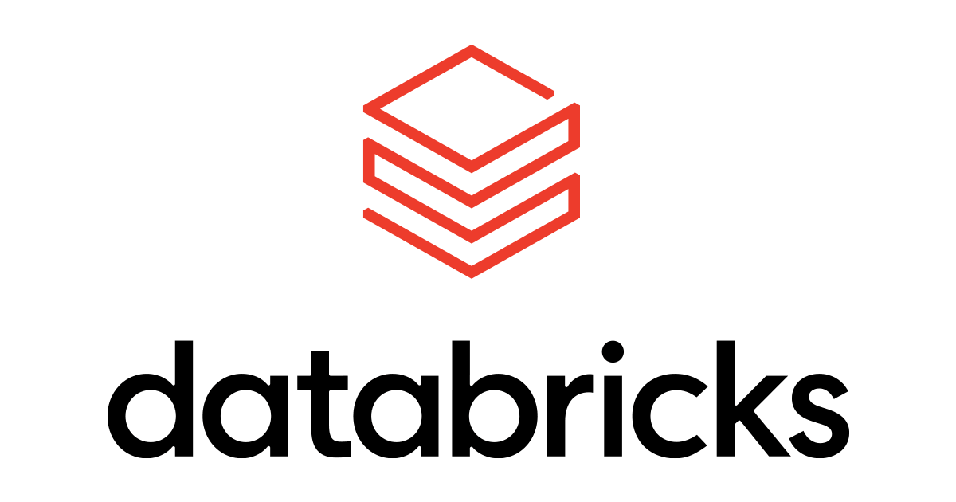
ML Flow

Slide 2
What is Databricks
Databricks is basically a Cloud-based Data Engineering tool that is widely used by companies to process and transform large quantities of data and explore the data. This is used to process and transform extensive amounts of data and explore it through Machine Learning models.

Slide 3
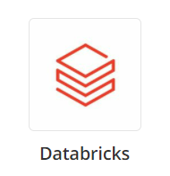
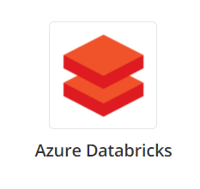
Databricks vs Azure Databricks
Databricks | Azure Databricks
Databricks is an American enterprise software company founded by the creators of Apache Spark. | Microsoft has integrated Databricks with Azure services which is known as Azure Databricks.
Supports all cloud service AWS, Microsoft Azure and Google Cloud. | It is specifically used in Azure.

Slide 4
Mlflow
MLflow is an open source platform for managing the end-to-end machine learning lifecycle. It has the following primary components:
Tracking: Allows you to track experiments to record and compare parameters and results.
Models: Allow you to manage models from a variety of ML libraries to a variety of model serving and inference platforms.
Model Registry: Allows you to centralize a model store for managing models’ full lifecycle.
MLflow supports Java, Python, R, SQL and REST APIs.

Slide 5
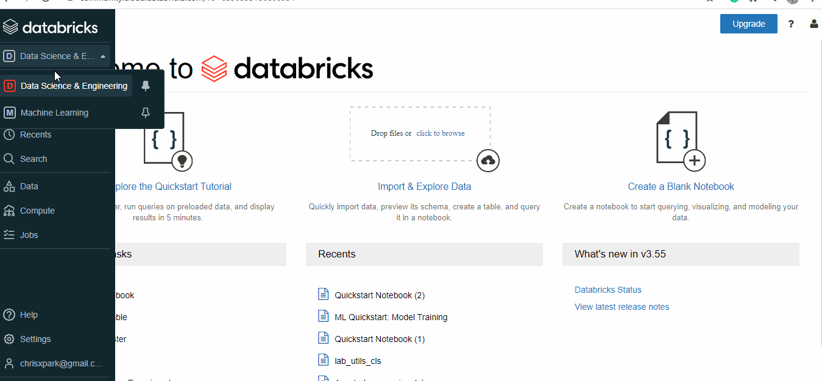
Databricks Roles
Databricks community edition is free to use, and it has 2 main Roles:
1. Data Science and Engineering
2. Machine learning.

Slide 6
Cluster
An Databricks cluster is a set of computation resources and configurations on which you run data engineering, data science, and data analytics workloads, such as production ETL pipelines, streaming analytics, ad-hoc analytics, and machine learning.You can manually terminate and restart an all-purpose cluster.

Slide 7
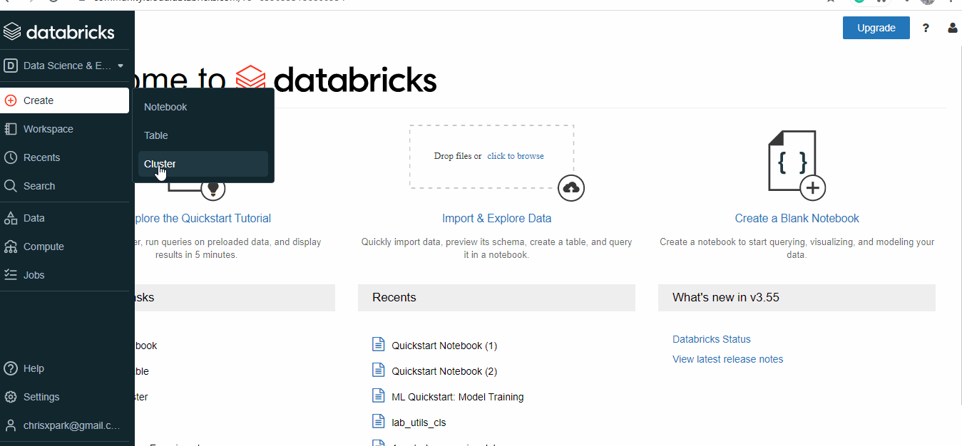
How to create cluster?
The easiest way to create a new cluster is to use the Create button:
Click Create in the sidebar and select Cluster from the menu. The Create Cluster page appears.
Name and configure the cluster.
There are many cluster configuration options, which are described in detail in cluster configuration.

Slide 8
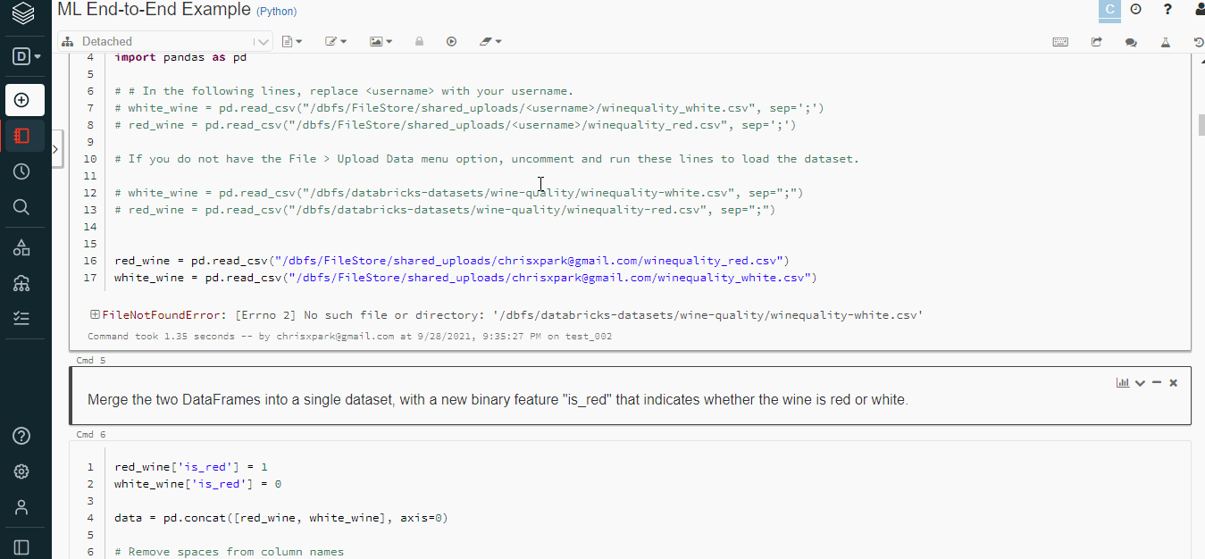
Create a notebook
Select create option and then click on notebook.
Provide a relevant name to the notebook.
Select language of preference – SQL, Scale, Python, R.
Select a cluster for the notebook to run on.

Slide 9
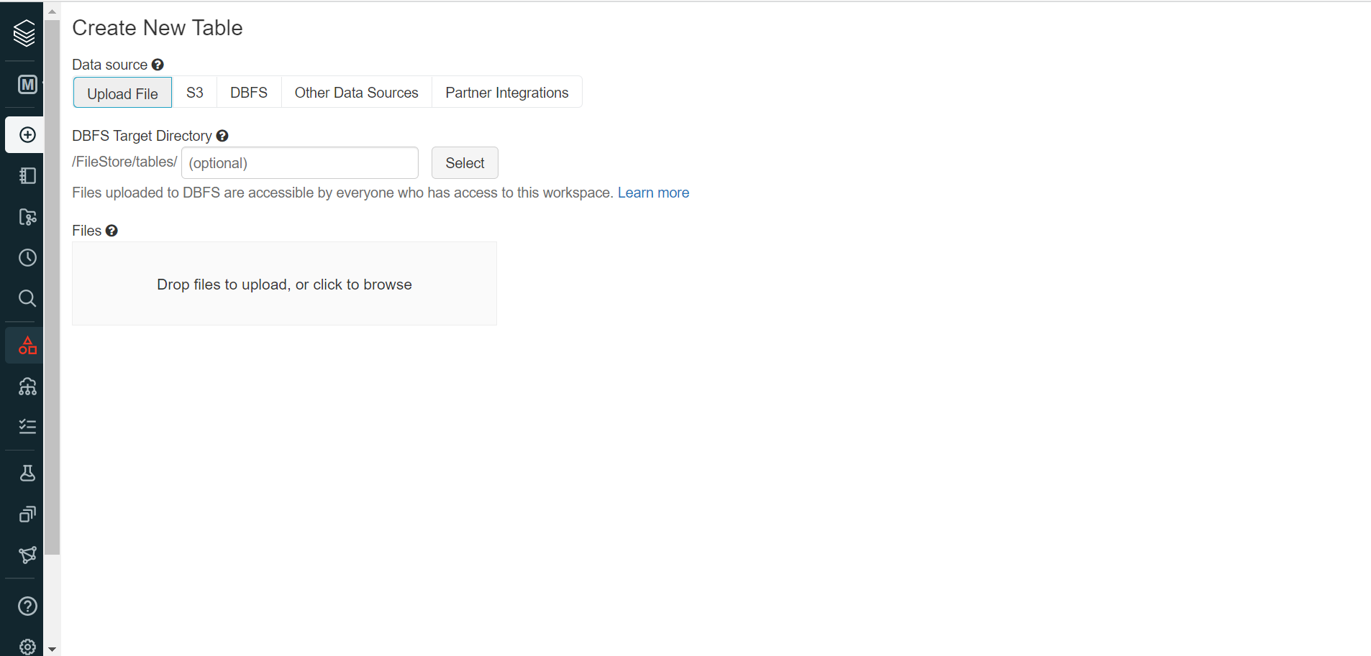
How to best use the Databricks environment
1) A new feature Upload Data, with a notebook File menu, uploads local data into your workspace.
2)however, you can select the destination and use the code from the Upload File dialog to read your files. In our case, we select the pandas code to read the CSV files.
NOTE:Directly we can upload from local system.

Slide 10
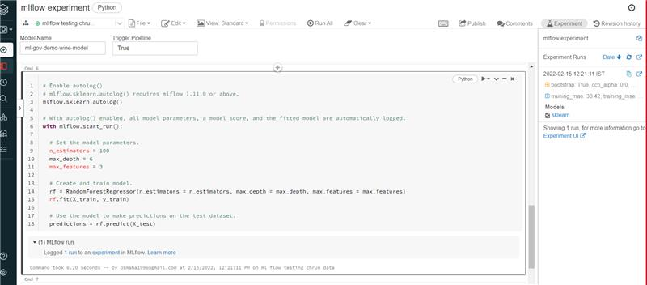
Evaluation of a Model
Here we are training, testing and evaluating Dataset.
By clicking on the Experiment, a side panel displays a tabular summary of each run’s key parameters and metrics, with ability to view detailed MLflow entities: runs, parameters, metrics, artifacts, models, etc.

Slide 11
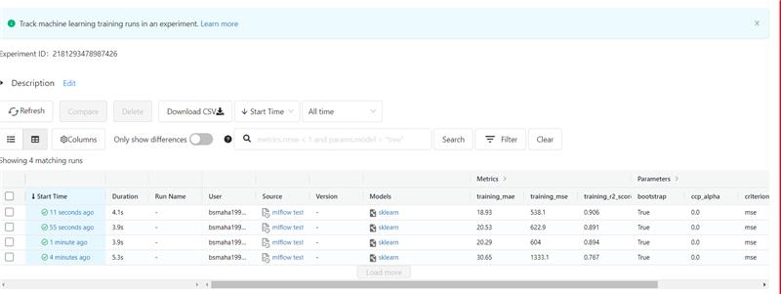
Mlflow Experiment
Image shows the Mlflow Experiment which includes model prediction details.

Slide 12
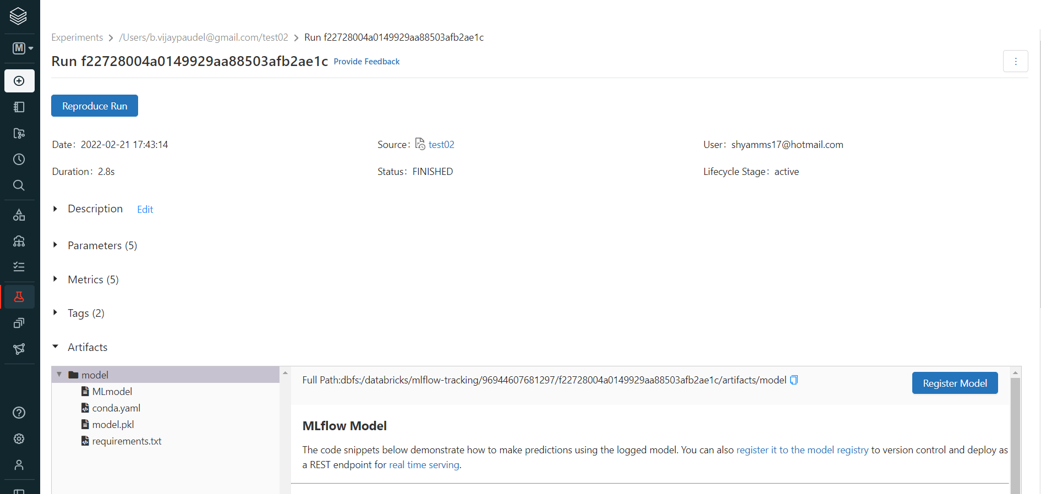
Model Registry
A model registry is a repository used to store trained machine learning (ML) models. In addition to the models themselves, a model registry stores information about the data and training jobs used to create the model.
Steps to Register a model:
From Experiment click on model to be saved.
Click on Register Model button.
Name the model -> Save Model

Slide 13
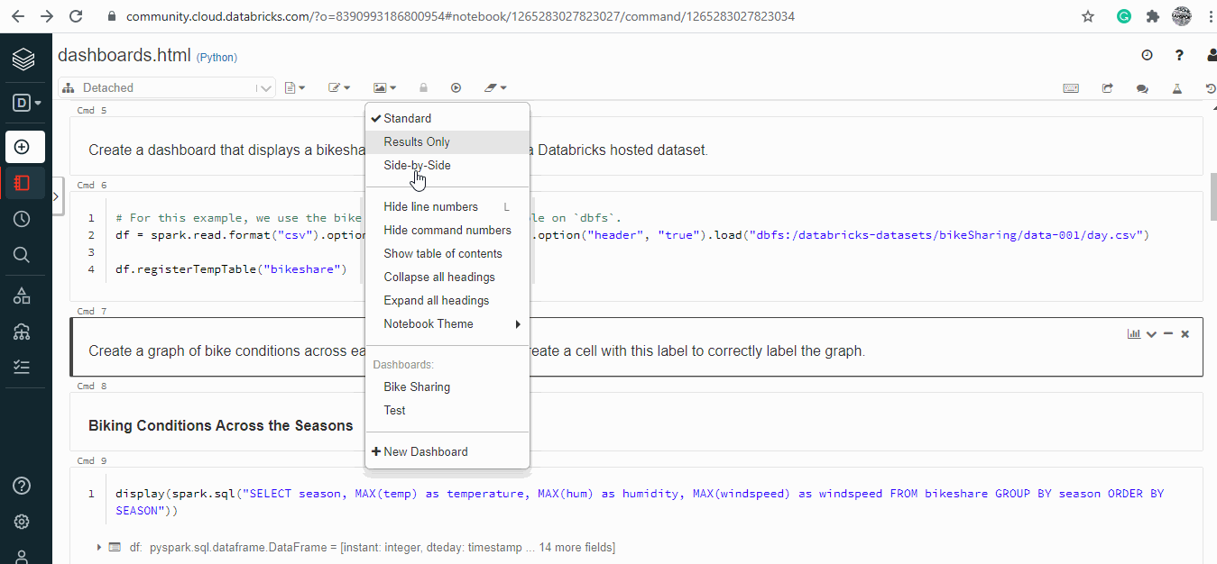
Dashboarding on Databricks
Databricks has a feature to create an interactive dashboard using the already existing codes, images and output.
Move to View menu and select + New Dashboard
Provide a name to the dashboard.
On the Top Right corner of each cell click on the tiny Bar Graph image.
It will show the available dashboard for the notebook.

Slide 14
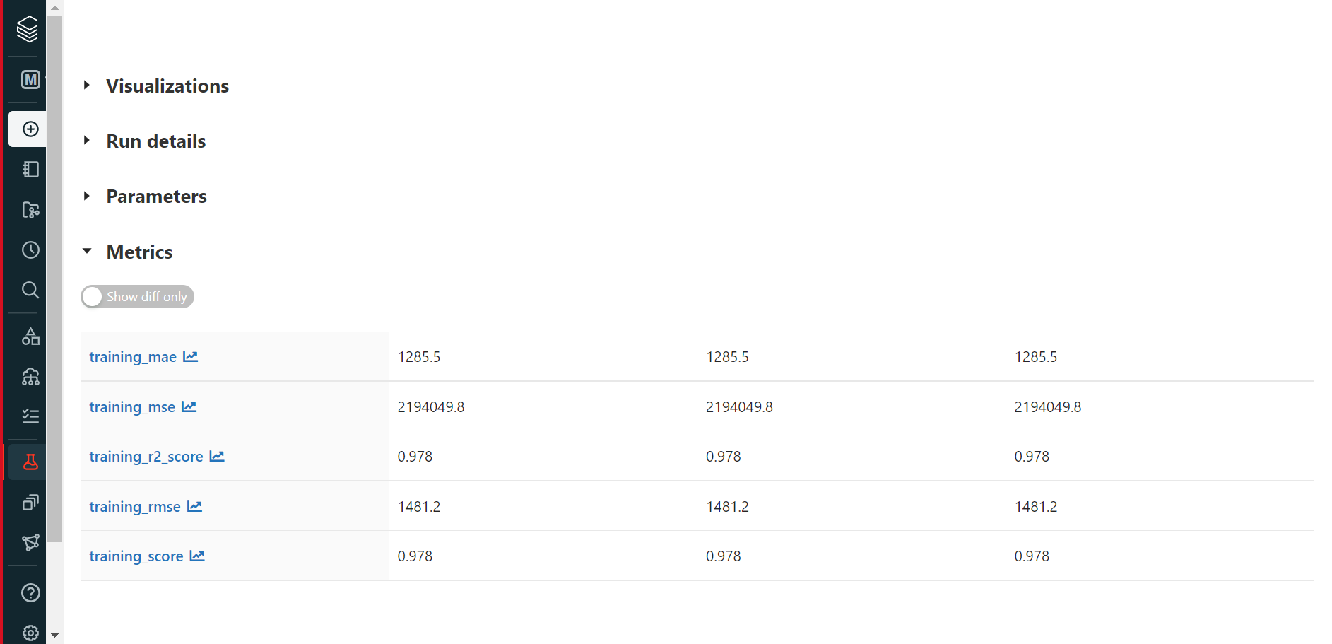
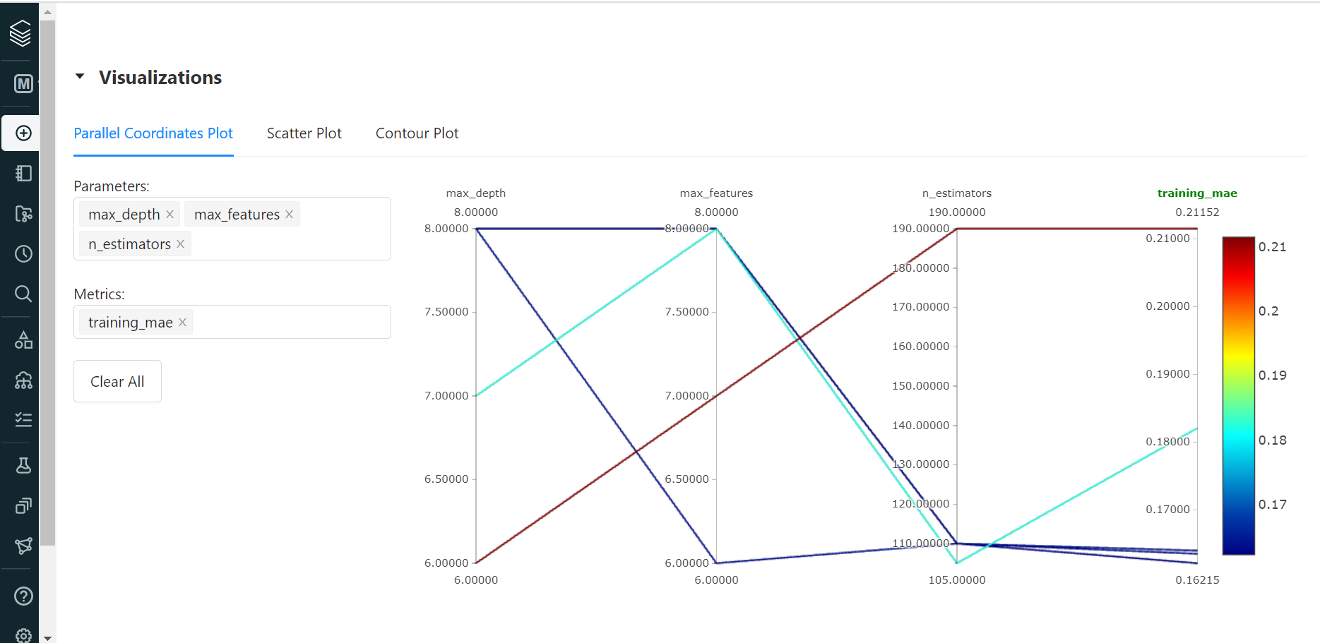
Comparing Models
In Experiment we can compare score and see graphs of different models through this feature in Databricks.

Slide 15
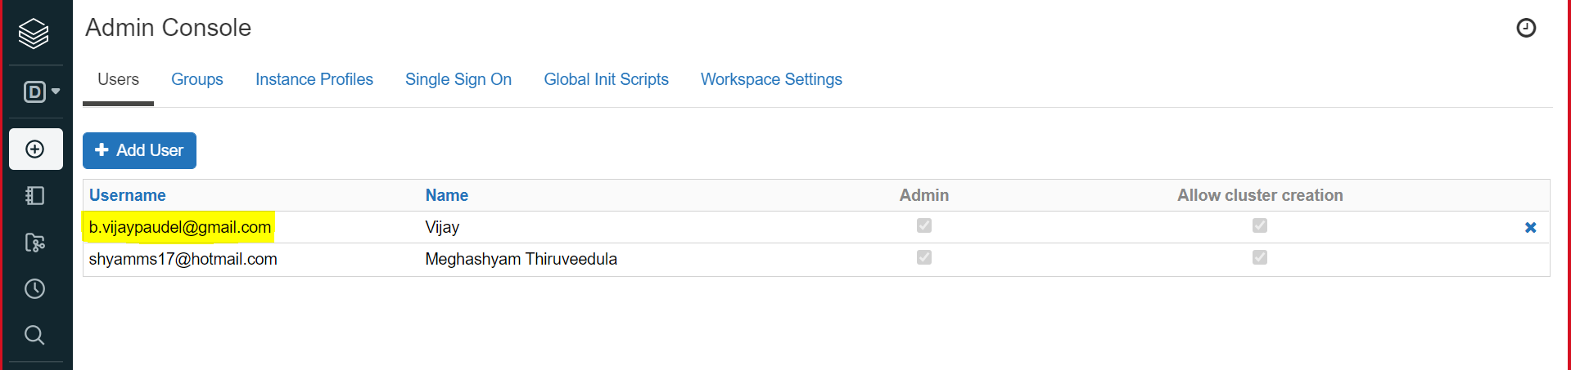
File Sharing
Steps to add new User:
Go to Settings -> Admin Console.
Click on Add User Button.
Provide user's Email ID.
User will get a mail where user need to set password.
User can now login

Slide 16
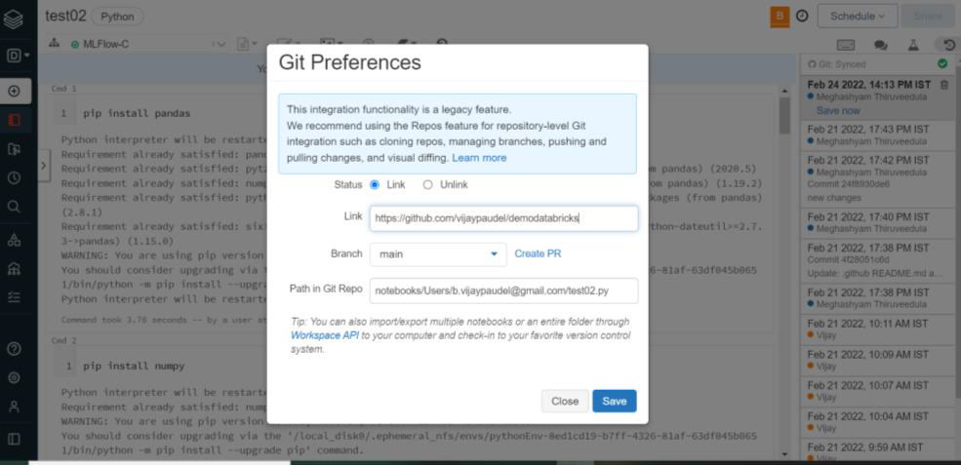
Syncing Notebook to Git
Add Git Preferences to link Databricks Noteook to Git.

Slide 17
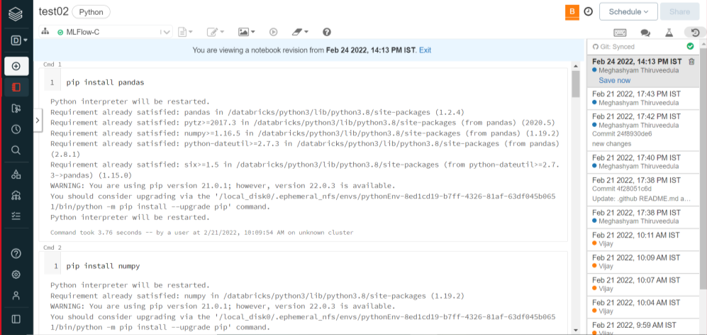
Synced Notebook
After notebook is updated we need to go to Rivision History and click on Save Button.
Changes will be reflected in Git.

Slide 18
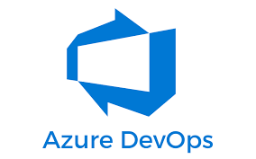

Deployment
Deployment in Azure portal can be done in 2 ways:
Github
Azure Devops

Slide 19
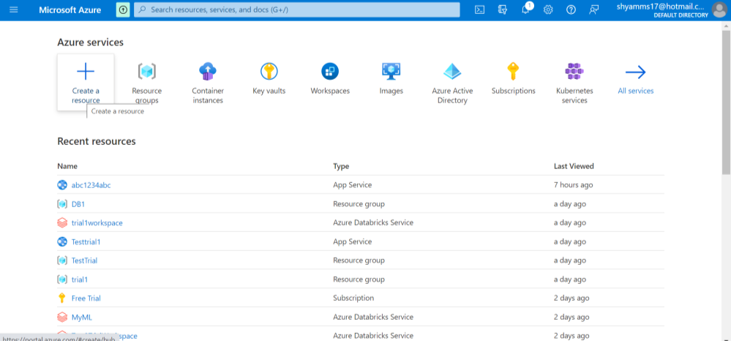
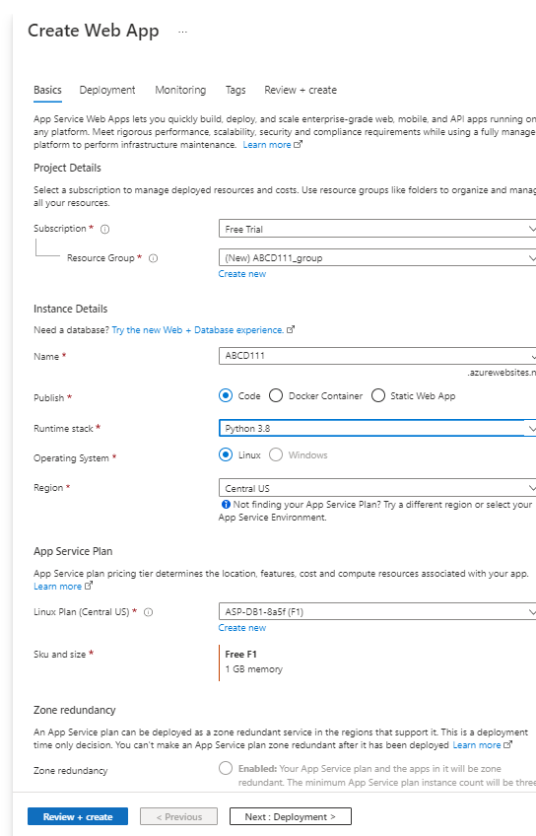
Deployment via Azure Devops
Create Microsoft azure account-->Click on CREATE RESOURCE-->Create WEB APP-->Click on Review+Create-->Click on Create

Slide 20
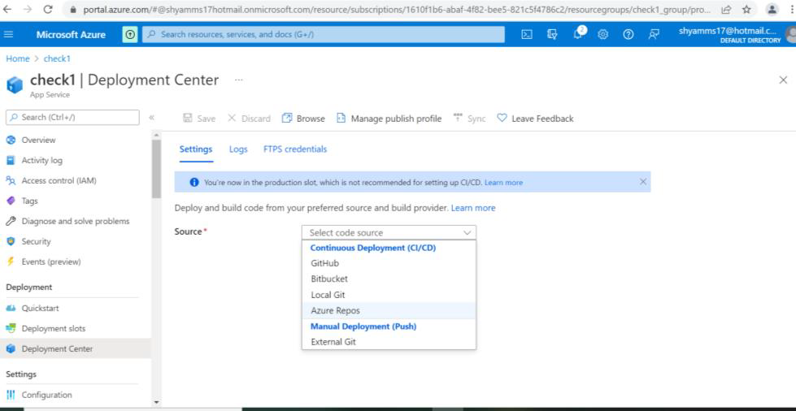
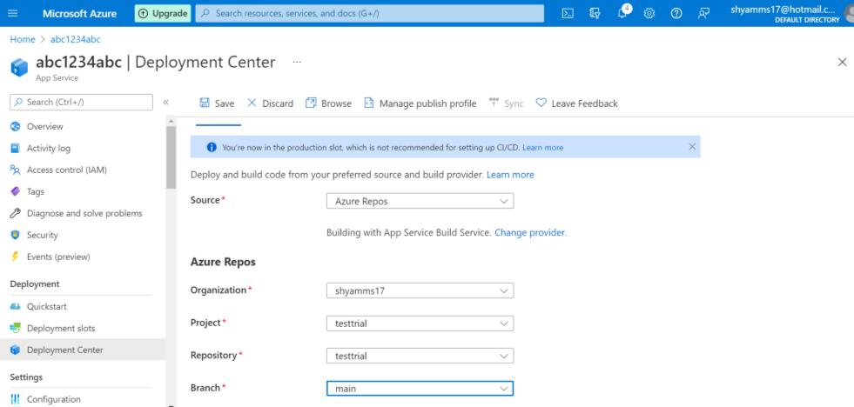
Selecting Repository
After Successful Deployment go to Deployment Center on left-->Under Source select Azure Repos-->Select Appropriate options-->Click on Save
To deploy through git select Github option.

Slide 21
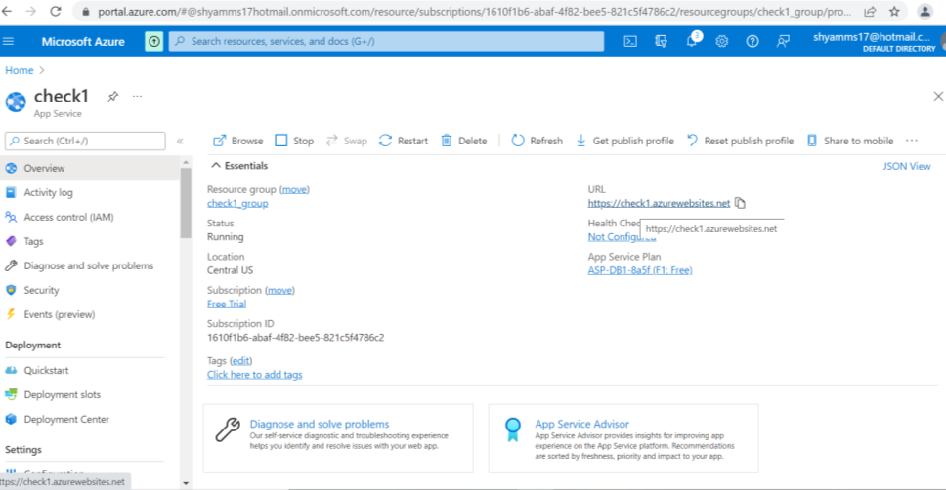
Deployment Completion
After successful deployment we will get auto-generated URL for our application.

Slide 22

Prediction Input Screen

Slide 23

Prediction Output Screen

Slide 24
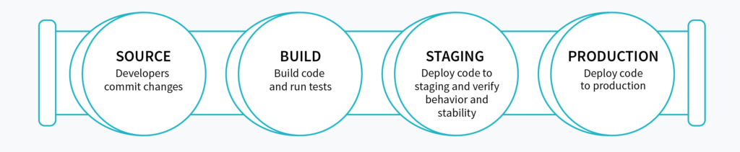
CI/CD Pipeline
CI/CD is the combined practices of continuous integration and either continuous delivery or continuous deployment. CI/CD bridges the gaps between development and operation activities and teams by enforcing automation in building, testing and deployment of applications

Slide 25
Overview of Azure Databricks CI/CD pipeline
Continuous integration:
1 Code
Develop code and unit tests in an Azure Databricks notebook or using an external IDE.
Manually run tests.
Commit code and tests to a git branch.
2 Build
Gather new and updated code and tests.
Run automated tests.
Build libraries and non-notebook Apache Spark code.
3 Release
Generate a release artifact
Continuous delivery: 1 Deploy
Deploy notebooks.
Deploy libraries.
2 Test
Run automated tests and report results.
3 Operate
Programmatically schedule data engineering, analytics, and machine learning workflows.

Slide 26

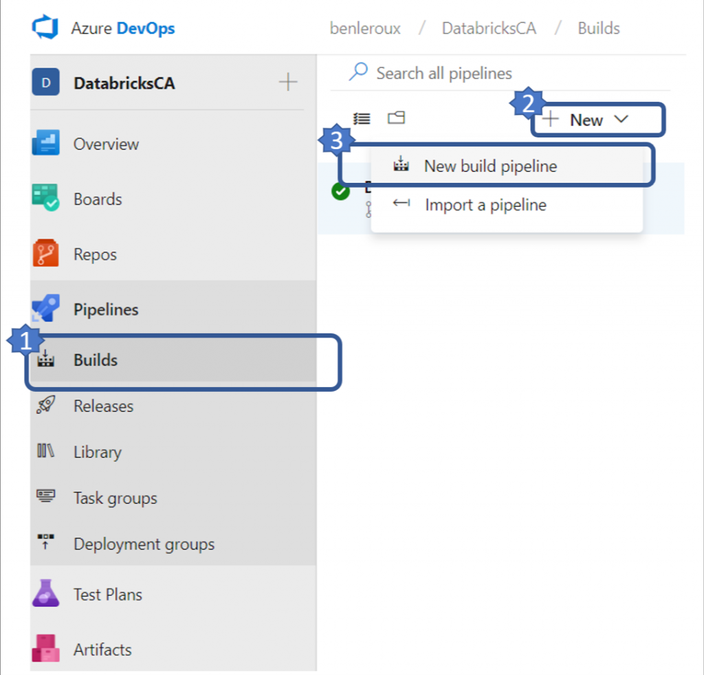
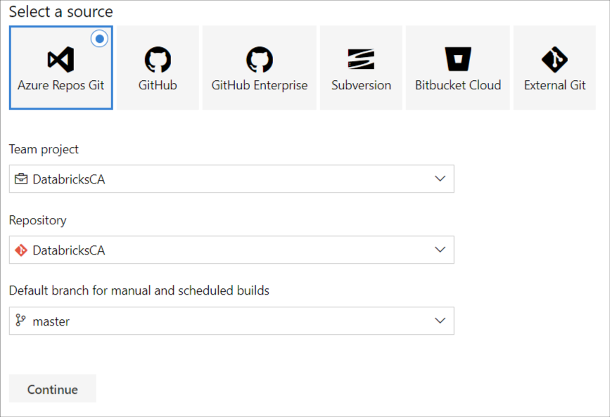
Creating a new build pipeline

Slide 27
Steps for pipeline
Pressing "Continue" will bring you to the template selection screen. The pipeline we're building involves pulling the changes from the master branch and building a drop artifact which will then be used to push to Azure Databricks in the CD part. Knowing this, pick "Empty job".
Name your build pipeline ADBDemo-CI and pick Hosted VS2017 pool.
Next, you will click on the "+" sign next to "Agent job 1" which will bring up the list of tasks available to you. Search and add "Publish Build Artifacts".

Slide 28
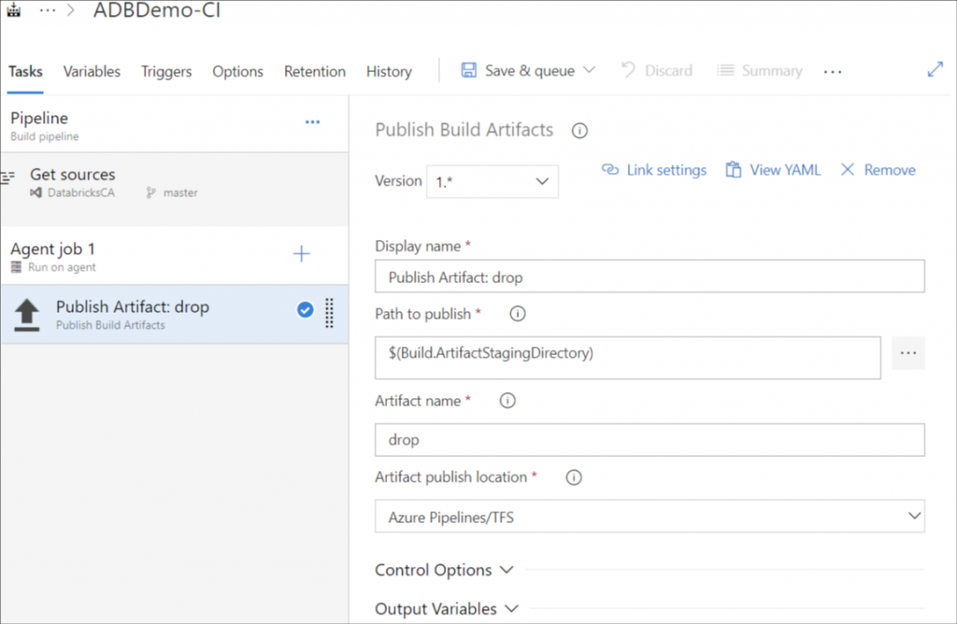
Steps for pipeline
Once added, click on the added task and your screen should now look like:
The Path to publish indicates which folder in your git repository you would like to include in your build.
The Artifact name identifies the name of the package you will use in the release pipeline. You can keep it as "drop" for simplicity.

Slide 29
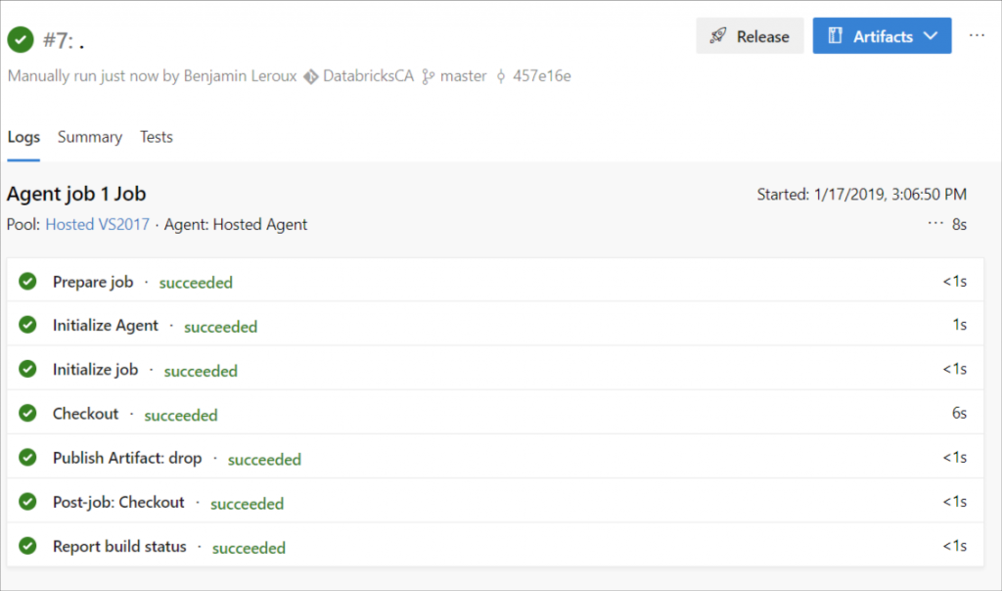
Saving your build
Once you've defined your build pipeline, it's time to queue it so that it can be built. This is done by selecting the "Save & queue" or the "Queue" options. Doing so will ask you save and commit your changes to the build pipeline.
Once completed you should see green check marks on all the steps.

Slide 30
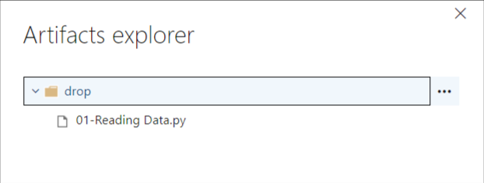
Viewing the content of the build
You can inspect the content of your build by clicking the "Artifact" blue button on the top right. Doing so will allow you the browse the content like so:

Slide 31
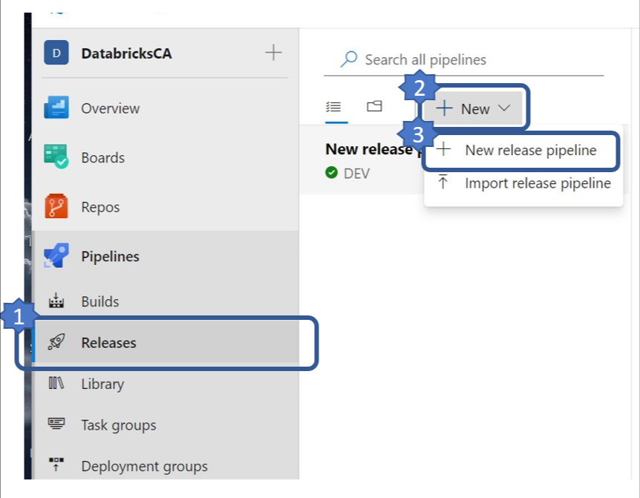
Building the release pipeline

Slide 32
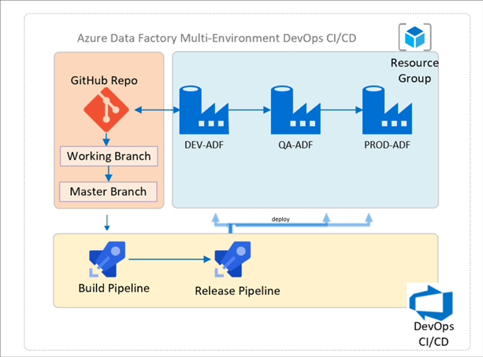
Creating a new release pipeline

Slide 33
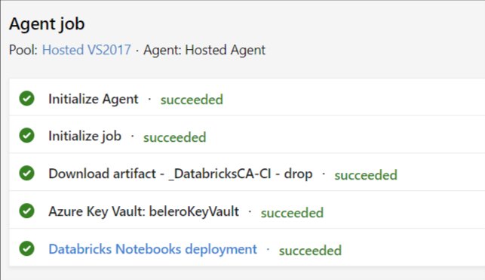
Tracking Process
Like before, click the "Release-#" link on the top left to see the progress.
If you verify the logs and you release ran successfully, you should see green check marks all across the board.

Slide 34
References
https://www.thedataguy.blog/ci-cd-with-databricks-and-azure-devops/#all-is-done
https://medium.com/geekculture/ci-cd-on-azure-databricks-using-azure-devops-82441386c6e8
https://docs.databricks.com/clusters/create.html
https://databricks.com/product/azure
https://databricks.com/blog/2017/11/15/introducing-azure-databricks.html

